Slide 1
WeatherBot – A Chatbot weather Assistant
🌡️
🌞
A chatbot for real-time weather updates using Rasa
Repository: https://github.com/katerinamas/-WeatherChatbot.git
Katerina Mastrofoti

Slide 2
Introduction
What is a Weather Bot?
- A chatbot designed to provide weather updates.
- Fetches real-time weather data based on user input.
Why Build a Weather Bot?
- Helps users check temperature, weather conditions, and sunrise time easily.
- Demonstrates chatbot capabilities using NLP and API integration.
⛅

Slide 3
Theoretical Background
What is a Chatbot?
🤖
A chatbot is an AI-powered program that simulates human conversation.
Uses Natural Language Processing (NLP) to understand and respond to users.
Can be rule-based (predefined responses) or AI-based (learning from interactions).

Slide 4
Understanding the Rasa Framework
What is Rasa?
Open-source framework for building AI chatbots Supports NLU (Understanding) & Dialogue Management Can integrate with APIs & handle complex conversations
Why Use Rasa?
Fully customizable & open-source Understands context & handles complex dialogues Easy API integration for dynamic responses
⚙️

Slide 5
Understanding the Rasa Framework
Key Components
Rasa NLU → Understands user input (intents & entities) Rasa Core → Manages conversation flow & decisions
Key Concepts
Intents: User intentions (e.g., ask_weather)
Entities: Extract data (e.g., city: Paris)
Slots: Stores extracted data for conversation memory Responses: Predefined bot replies
Actions: Executes custom logic (e.g., calling APIs)
Stories & Rules: Define chatbot conversation flows

Slide 6
How Does the Weather Bot Work?
☔
1. User asks a weather-related question.
2. The bot classifies the user’s intent.
3. Extracts relevant entities like city name.
4. Fetches weather data from an external API.
5. Responds with formatted weather information.
User: "What’s the temperature in Paris?" Rasa NLU → Identifies intent & extracts city: Paris Rasa Core → Calls action_get_temperature Action → Fetches data from API Bot Response → "The temperature in Paris is 15°C."

Slide 7
API Integration
☁️
☁️
Weather API Used: OpenWeatherMap API
How It Works:
- User provides city name.
- Chatbot sends a request to the API.
- API returns temperature, condition, sunrise time.
- Bot processes and presents the information.

Slide 8
Dialog Policy Experimentation
Memoization Policy:
Remembers frequently occurring conversation patterns.
TED Policy:
Learns from past dialogues to predict responses.
Rule Policy:
Handles structured responses (greetings, fallback).
Why these choices?
Balances learning from conversations with predefined rules.
Ensures bot can handle both structured and free-flowing interactions.

Slide 9
Interaction Scenarios
NLU: Understanding User Input
Intents → Define user goals (ask_temperature, ask_weather_situation)
Entities → Extract structured data (e.g., city: Paris)
Example Utterances → Train chatbot to recognize user queries
Example:
User: "What's the temperature in New York?"
Intent: ask_temperature
Entity Extracted: city: New York
❄️

Slide 10
Interaction Scenarios
🌦️
Stories: Defining Conversation Flow
Stories → Predefined dialogue paths for different scenarios
Example Stories: User: "What's the weather in Berlin?" Intent: ask_weather_situation Bot Calls Action: action_get_weather_situation Bot Responds with API Data
Domain: Defining Bot Capabilities
Actions: Custom logic (action_get_temperature)
Responses: Predefined messages (utter_ask_city)
Slots: Store user data (e.g., city)
Handling Edge Cases
Missing Information? → utter_ask_city prompts user
Off-topic Queries? → utter_irrelevant politely declines
FAQs? → utter_capabilities explains bot functionalities

Slide 11
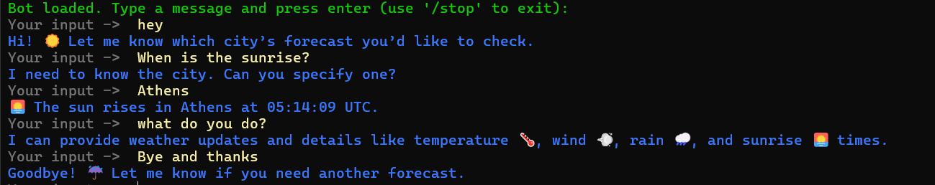
Example Interactions

Slide 12
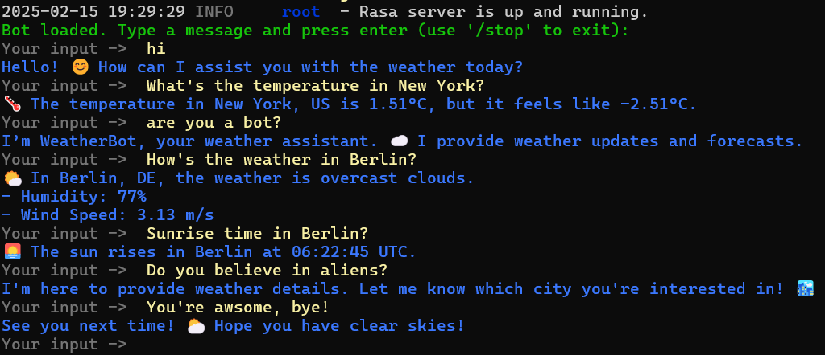
Example Interactions

Slide 13
Future Improvements
🔮
Expand Training Data: Improve intent recognition with more diverse user queries
More Weather Insights: Provide forecasts, air quality index. Severe Weather Alerts: Integrate real-time weather warnings for storms, heatwaves, and other extreme conditions. Hourly Forecasts: Allow users to check temperature and precipitation trends throughout the day.
Conversational Memory: Allow the bot to remember previous queries for better follow-ups.
Integrate alternative APIs to increase accuracy and provide more data.
Location-based Recommendations: Use GPS or saved locations for automatic city recognition.
Chatbot Expansion Beyond Weather Road Condition Alerts: Provide real-time traffic/weather reports for travelers. Suggest best times to visit places based on climate trends.

Slide 14
Conclusion
🌈
The Weather Bot efficiently provides weather updates via conversation.
Integrates NLU, API calls, and structured dialogue management.
Future improvements will enhance accuracy and usability.
☀️

